Slide 1
Syndromic Approach to Diagnosis & Management of Poisoning

Slide 2
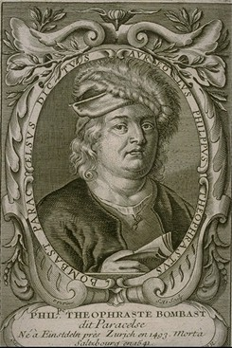
The Dose Makes The Poison
“What is there that is not poison? All things are poison and nothing [is] without poison. Solely the dose determines that a thing is not a poison”
Philip Theophrastus Bombast von Hohenheim
aka PARACELSUS (1493-1541)

Slide 3
Management
Most toxic exposures will get better simply with meticulous supportive care
Not everybody needs the full court press
Issues to address
frequent assessment
decontamination
enhancement of elimination
Antidotes
Toxidromes

Slide 4
General Approach ABC’s of Toxicology
A-Antidotes and alter absorption (in some instances prior to airway-decontamination with organophosphates to protect others, cyanide toxicity where antidotes are lifesaving)
B-Basics; ABC’s
C-Change metabolism (NAC, ethanol)
D-Distribute differently (calcium gluconate, O2)
E-Elimination (diuresis, dialysis, hemoperfusion)

Slide 5
Basic approach:
Airway, breathing, circulation
Establish IV, O₂ and cardiac monitor
Consider coma cocktail
Thiamine, D50, Naloxone
Evaluate history and a thorough physical exam
Look at vitals, pupils, neuro, skin, bowel sounds. . .
Gives you hints regarding the general class of toxins
Guides your supportive care
Draw blood / urine for testing
Time to consider decontamination options

Slide 6
Frequent Assessment
Beware of the “Stable” patient
Consider possible polysubstance exposures
Be prepared for deterioration
IV access
Cardiac monitor
Pulse oximetry

Slide 7
Decontamination Methods
Many “standard” practices now virtually extinct
Forced emesis, forced lavage, charcoal “anytime”
Removal of contaminated clothing, substances on skin or in eyes
Charcoal
Gastric lavage
Whole Bowel Irrigation

Slide 8
Decontamination Methods- Gastric Lavage
Used far less now than in past
Having “stomach pumped,” with large tube inserted into stomach, suctioned, and lavaged
Risk of perforation, aspiration, and simply not working
Contraindicated in comatose or seizing patients, unprotected airways, extended release preparations

Slide 9
Gastric Lavage
Can be a brutal procedure
Indication: life threatening ingestions that occurred within one hour
Airway protection is key
Limited indications
Lots of complications
Notes:
DO not lavage tylenol, do not lavage an SSRI

Slide 10
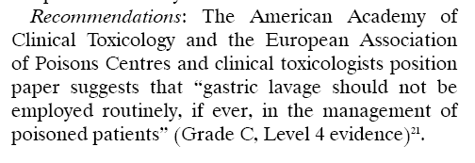
Gastric lavage
Peter JV, Moran JL, Pichamuthu K, Chacko B. Adjuncts and alternatives to oxime therapy in organophosphate poisoning – is there evidence of benefit in human poisoning? A review. Anaesth Intensive Care 2008; 36: 339-50

Slide 11
Charcoal
Basically, everybody gets a dose
Works to adsorb substances to its matrix
Not for metals, caustics
Generally safe, few contraindications
Aspiration, bowel obstruction
Dosing 1g/kg po dose, +/- single dose of cathartic
Notes:
Charcoal is made by heating wood pulp, washing then activating it with steam or strong acids. The subsequent network of tiny pores is capable of trapping toxins. Does not bind well to: CN, lead, Li, boron, boric acid, some pesticides, iron, ethanol, strong acids or alkalis. Usually try to achieve a 10:1 ratio – 10 gm charcoal to 1 gm of drug.

Slide 12
Charcoal Contraindications - Charcoal doesn’t bind CHARCOAL
Caustics and corrosives
Heavy metals
Alcohols
Rapid absorption (cyanide, strychnine)
Chlorine and iodine
Other agents insoluble in water
Aliphatics (petroleum distillates)
Laxatives (Mg, K, Na)

Slide 13
Charcoal Contraindications
Loss of protective reflexes
drugs likely to cause rapid depressed consciousness or early seizures
infants < 6 months of age
ingested foreign body
neurologically impaired
absent bowel sounds or obstruction
unstable patients

Slide 14
Multi-dose Charcoal “Gut Dialysis”
“Pretty Damn Short QT_{c}
Phenobarbital
Dapsone
Salicylates
Quinine
Theophylline
Carbemazepine

Slide 15
Whole Bowel
Isotonic polyethylene glycol electrolyte solutions
Large volumes ingested “wash” the substances through the bowel
cleanses gut of intoxicants
PEG solutions at 2 Liters/hour
effective for use in LA preparations, body packers/stuffers, and some substances poorly absorbed by charcoal (ex iron)
contraindicated if hematemesis, ileus, obstruction, perforation, or peritonitis
Dose in volume sufficient to create clear rectal effluent
Notes:
Not absorbed, isotonic so no risk of dangerous fluid shifts

Slide 16
Enhancement of Elimination
In other words, get rid of the toxin faster
Cathartics - used, but no study showing benefit
Alkalinization – salicylates
Hemodialysis
Hemoperfusion

Slide 17
Antidotes
Very limited number of antidotes given the vast array of pharmaceuticals and chemicals
“Coma Cocktail”
glucose
thiamine
naloxone
** NOT flumazenil**

Slide 18
Common Antidotes
Toxin
Paracetamol
Tricyclics
Opiates
Organophosphates
Heavy metals
Iron
Digoxin
Beta-blocker
Calcium channel blockers
Cyanide
Antidote
N acetylcysteine
Na bicarbonate
Naloxaone
2 PAM
BAL
Desferoxamine
Dig Fab (Digibind)
Glucagon
Calcium, glucagon, gluc/insulin
Sodium nitrite, sodium thiosulfate, hydroxycobalamine

Slide 19
Common Antidotes
Toxin
Methanol, ethylene glycol
Methemoglobinemia
Anticholinergics
Isoniazid
Snakebites
Antidote
Fomepizole (Antizole)
Methylene blue
Physostigmine
Pyridoxine
Antivenom

Slide 20
High Risk Patients (ICU wannabees)
Needs circulatory or respiratory support
altered mental status > 3 hours
seizures
arrhythmia
second or third degree heart block
widened QRS
unresponsive to verbal stimuli
arterial pCO₂ > 45 mmHg

Slide 21
Our patient. . .
29 year old man
found “down”
Ex-room mates transport to ED
Reports from scene: “he took something”
No pill bottles on scene
No family with him
Roommates that found him are long gone
He is now in your ED

Slide 22
We can. . .
Start with the basics
Airway, breathing, circulation
Get a better history
Get relatives to get pill bottles, tell you what they do know (found outside, inside, garage…)
Call friends, family, neighbors
Call psych or primary physician to know regular drugs
Get him to tell
Always remember that suicidal patients (just like everyone else) can lie so be skeptical of their history

Slide 23
Toxicologic Physical Exam
CNS – level of arousal, GCS, pupils, behaviour, neurologic exam
CVS – rate, rhythm
Resp – pattern, depth, wheezing
GI – bowel sounds, distention
Skin – color, temp, signs of trauma
Odors
Notes:
Brief, but detailed physical exam, hyperalert – look for anticholinergic toxidrome, big pupils AAAS, small pupils COPS, nystagmus –PCP, phenytoin GI – may alert to toxidrome or to contraindication to decon methods

Slide 24
Directed Toxicology Tests
Comatose: Tox screen, glu, NH₄, CT scan, CSF analysis
Respiratory toxin: ABG, CXR, spirometry, pulse ox
Cardiac toxin: EKG, ECHO, cardiac enzymes, hemodynamic monitoring

Slide 25
Tox Screens
Toxic screening is rarely necessary when patients are asymptomatic or have clinical findings consistent with the medical history.
However, screening for acetaminophen and salicylates is strongly recommended for patients with an uncertain history or intentional poisoning

Slide 26
Or. . .
Establish a pattern to his symptoms
Toxic syndrome
Also known as a:
TOXIDROME

Slide 27
What is a toxidrome?
It is the association of several clinically recognizable features, signs, symptoms, phenomena or characteristics which often occur together, so that the presence of one feature alerts the physician to the presence of the others.

Slide 28
Toxidrome
Symptoms
&
Signs
History
Vital signs
Simple labs

Slide 29
Toxidromes
Not every drug fits into a broad based category
Lots of meds have unique effects not easily grouped
“Physiologic fingerprints” that occur in the form of syndromes or groups of symptoms which are observed to occur together in response to exposure to one of a pharmacologically similar group of agents
Useful in determining the class of agents involved in an unknown poisoning

Slide 30
6 Basic Toxidromes
Sympathomimetics
Anticholinergics
Cholinergics
Opiates
Seditive Hypnotics
Neuroleptic Malignant Syndrome – Serotonergic syndrome (Hallucinogenic)

Slide 31
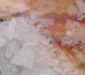
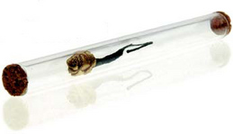
Toxidromes: Sympathomimetic

Slide 32
Sympathomimetics
Cocaine
Methamphetamine/Amphetamines
Ecstasy (MDMA)
ADHD meds like ritalin, adderal
Ephedrine
Caffeine

Slide 33
What goes wrong?
Tachycardia +/- arrythmias
Hypertension +/- ICH
Hyperthermia,
mydriasis,
convulsions, diaphoresis, seizure,
central nervous system (CNS) excitation
psychosis,
Rhabdomyolysis
Mimics Anticholinergic except WET compared to DRY
Diaphoresis and normal bowel sounds with sympathomimetic toxidrome
Dry skin and absent bowel sounds with anticholinergic toxidrome

Slide 34
What do we do about it?
Supportive care
Monitor airway, diagnose ICH, rhabdo
IVF for insensible loses and volume repletion
Benzos, benzos, benzos, benzos
BP mgmt if severe
NEVER GIVE BETA BLOCKERS

Slide 35
Toxidrome: Opiate

Slide 36
Opiates / Opioids
Opiate: derived directly from the opium poppy
morphine and codeine
Opioids: much broader class of agents capable of producing opium-like effects or of binding to opioid receptors
Heroin
Methadone
meperidine
Hydrocodone
Oxycodone

Slide 37
What goes wrong
Triad of:
Coma
Miosis (not always seen; demerol actually dilates)
Respiratory depression
Peripheral vasodilation, hypotension
Flushing (histamine)
Bronchospasm
Pulmonary edema
Seizures (meperidine, propoxyphene)
Hypothermia
Bradycardia

Slide 38
What do we do about it?
Competitive opioid antagonist: Naloxone
Goal of return of spontanous respirations sufficient to ventilate the patient appropriately
May have to re-dose as opiates may act longer than antagonist
There are other longer acting opioid antagonists such as nalmefene and naltrexone but not often used

Slide 39
Toxidrome: Anticholinergic

Slide 40
Anticholinergics
TCA
Scopolamine/polo
Neuroleptics
Parkinson meds
Benzotropine/trihexphendyl
Jimson weed
Antihistamines Methylqualone
Piperdones, Gyromitra

Slide 41
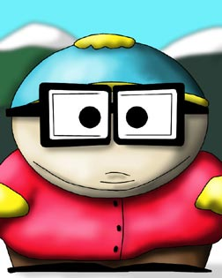
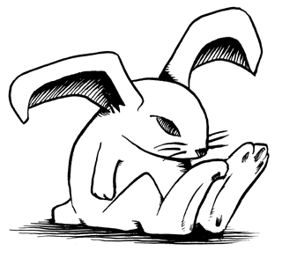
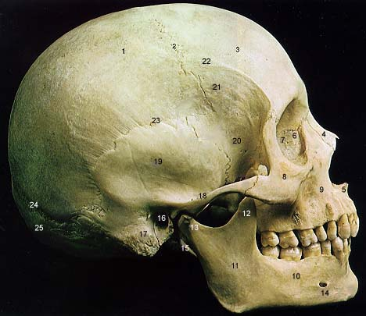
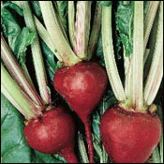
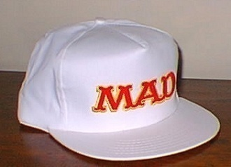
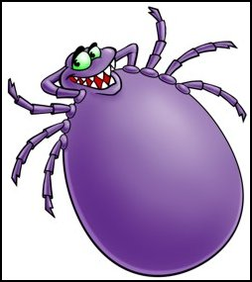
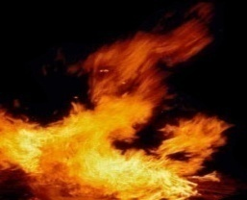
Better way to remember it. . .
Hot as Hades - Fever
Fast as a Hare - Tachycardia
Dry as a Bone – Lack of diaphoresis
Red as a Beet – Flushed skin
Mad as a Hatter – Delerium
Full as a Tick – Urinary retention
Blind as a Bat – Mydriasis

Slide 42
What do we do about it?
Supportive care
IVF to replace insensible losses from agitation, hyperthermia
Benzos to stop agitation
Physostigmine
Induces cholinergic effects
Short acting
May help with uncontrollable delirium
Do not use if ingestion not known
Danger with TCAs & CHB

Slide 43
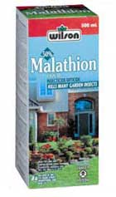
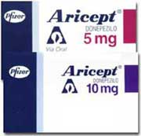
Toxidrome: Cholinergic

Slide 44
What goes wrong?
D - Diarrhea
U - Urination
M - Miosis
BBB – Bradycardia, Bronchorrhea, Bronchospasm
E - Emesis
L - Lacrimation
S – Salivation, Seizures

Slide 45
What do we do about it?
Antagonize muscarinic symptoms
Atropine
Stop aging of enzyme blockade
2-PAM
Prevent and terminate seizures
Diazepam
Supportive care

Slide 46
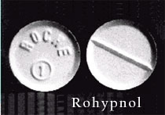
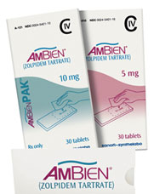
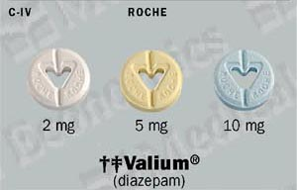
Toxidrome: Sed-Hypnotic

Slide 47
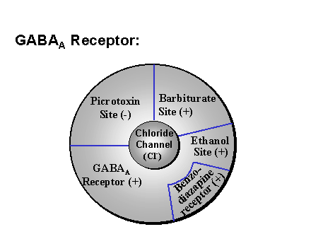
Why do they do?
Different agents have different mechanisms
Many interfere in the GABA system

Slide 48
What goes wrong?
CNS depression, lethargy
Can induce respiratory depression
Can produce bradycardia or hypotension

Slide 49
What do we do about it?
Supportive care
Be wary of the benzo “antidote” Flumazinil
Is an antagonist at the benzo receptor
RARELY INDICATED
If seizures develop either because of benzo withdrawal, a co-ingestant or metabolic derangements, have to use 2nd line agents, barbiturates, for seizure control

Slide 50
NEUROLEPTIC MALIGNANT SYNDROME (Serotonergic syndrome)
Rare, life-threatening
Reaction to neuroleptic medication
All anti-psychotics may precipitate
- typical or atypical
- potent neuroleptics most frequent

Slide 51
Drugs for NMS
Fluoxetine
Meperidine
Paroxetine
Sertraline
Trazodone
Clomipramine

Slide 52
NEUROLEPTIC MALIGNANT SYNDROME
Classic Symptoms
Fever
Altered Mental Status
Muscle Rigidity
Autonomic Dysfunction
Heterogeneous syndrome
Average onset 4-14 days after initiation of therapy
May occur at any time

Slide 53
NEUROLEPTIC MALIGNANT SYNDROME HISTORY
Recent treatment with neuroleptics
Within past 1-4 weeks
Chronic use, increased dose, newly instituted
Fever
Above 38 C
Muscle Rigidity

Slide 54
NEUROLEPTIC MALIGNANT SYNDROME PHYSICAL EXAMINATION
Altered Mental Status
Hyperthermia
Autonomic Instability
Tachycardia, hypertension, hypotension
Generalized Muscle Rigidity
Tremor

Slide 55
NEUROLEPTIC MALIGNANT SYNDROME TREATMENT
ABC’S
Stop all neuroleptics
IV fluid rehydration
Reduce Temperature
Cooled IV fluids
Cooling blankets
Ice packs
Pharmacotherapy

Slide 56
NEUROLEPTIC MALIGNANT SYNDROME PHARMACOTHERAPY
Benzodiazepines
Dopamine Agonists
Bromocriptine
Levodopa/Carbidopa
Reverse dopamine blockade
Skeletal Muscle Relaxants
Dantrolene
Inhibits calcium release from sarcoplasmic reticulum
Neuromuscular blockade

Slide 57
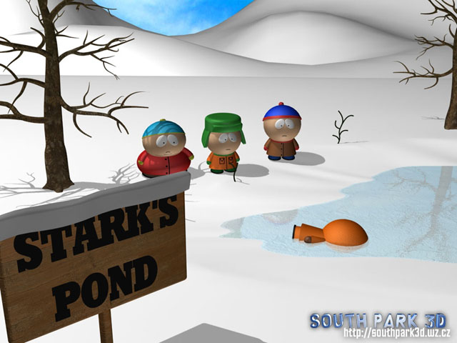
Now you know what do do with that patient found down

Slide 58
So back to our patient. . .
Agitated, pupils 8 mm, sweaty, HR 140’s, BP 230/130
Sympathomimetic
Unarousable, RR 4, pupils pinpoint
Opiate
Confused, pupils 8mm, flushed, dry skin, no bowel sounds, 1000 cc output with Foley
Anticholinergic
Vomiting, urinating uncontrollably, HR 40, Pox 80% from bronchorrhea, pupils 2 mm
Cholinergic
Lethargic, HR 67, BP 105/70, RR 12, pupils midpoint
Sedative Hypnotic

Slide 59
Conclusion: So back to our patient. . .
How do I treat him
Good supportive care, good physical examination
How do I decontaminate him
Charcoal as long as he is not an aspiration risk
What do I order
Chem, ASA, APAP, EKG at a minimum
Do I give him an antidote
Coma cocktail, others as indicated by labs
When can he go to psych?
Observe for 6 hours and re-evaluate

Slide 60
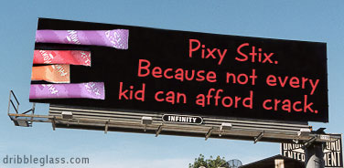
Thank you

